Slide 1
Week 5: CSI Camera & Data Collection
Tuesday, February 7th, 2023

Slide 2
Recap

Slide 3
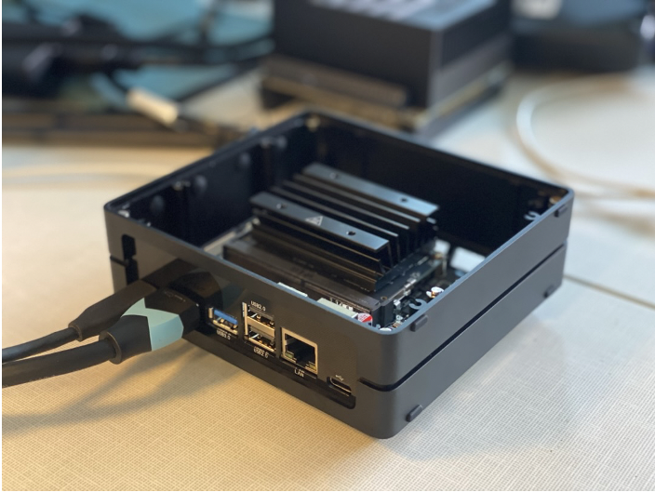
SSD Expansion and Memory Issue
Onboard memory was almost full
The CUDA drivers take up a lot of space on the edge device
Anaconda and Python require a lot of memory
Making full use of the SSD card installed requires partitioning
Follow the steps in Brightspace
https://tinyurl.com/2h3kjzhm
https://tinyurl.com/yckzkfj9

Slide 4
Today

Slide 5
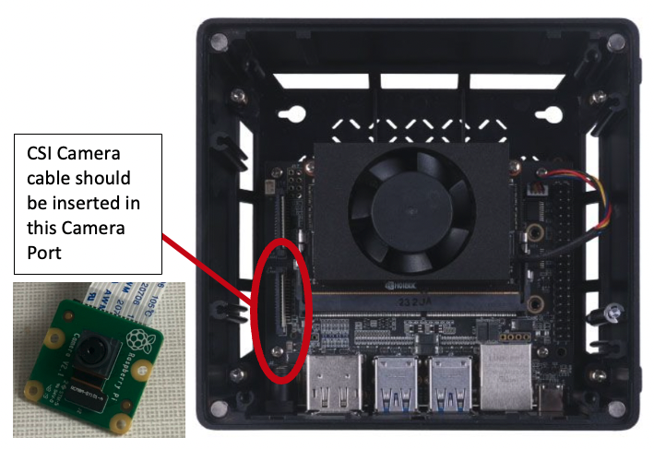
Cameras
Connect the CSI Camera correctly
Install the relevant libraries required to interface with the camera
Obtain live feed from the CSI Camera
Acquire images using camera sensor
Acquire a short video using the camera sensor

Slide 6
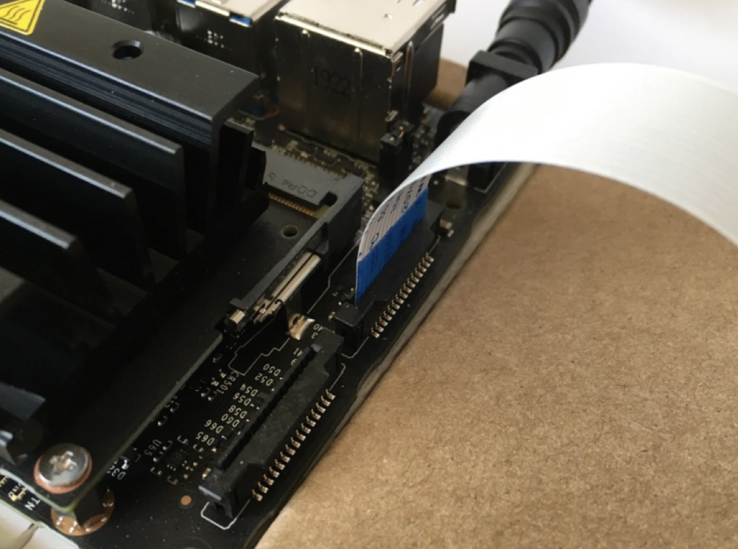
Connect the CSI Camera
Carefully lift the tab using you nails
Insert the cable with pins facing the device and the blue tape facing away
Push the tab back in
Device will need to be restarted
https://www.okdo.com/getting-started/get-started-with-jetson-nano-4gb-and-csi-camera/

Slide 7


Tasks
Obtain 10 images and save them to your folder using the approach from Step 9 of the lab.
Modify a Python code to acquire 10 images from the camera with a 5 second interval.
Copy and paste the 10 images acquired from Homework step 1 and 10 images acquired from Homework step 2 in two separate word documents. Then submit each document with the images and the Code file that you have modified on blackboard.

